Slide 1

Healthy Weight on FHIR CDC Analytics Reporting Application
Team-Too Deliverable 3: Progress Report
Notes:
Hi My name is Daniel hegberg.
David Bailey and I would like to provide an update on Team-Too’s progress on the CDC analytics reporting application

Slide 2



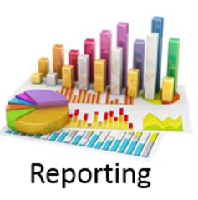
Project Goal: Develop application to better understand and prevent childhood obesity
Care Manager
Used by care manager to manage physician referrals
Patient
Provider
Used by patients to track behaviors relevant to obesity
Used by physicians to track and interpret patient data
Analytics & Reporting
Aggregates collected data and analyzes at a population level
In Development by
Team Too
Notes:
Our project is to develop the analytics & reporting component of the CDC application focused on understanding and preventing childhood obesity
This component of the tool is used to aggregate population level data and present a flexible dashboard for providers and care managers.

Slide 3
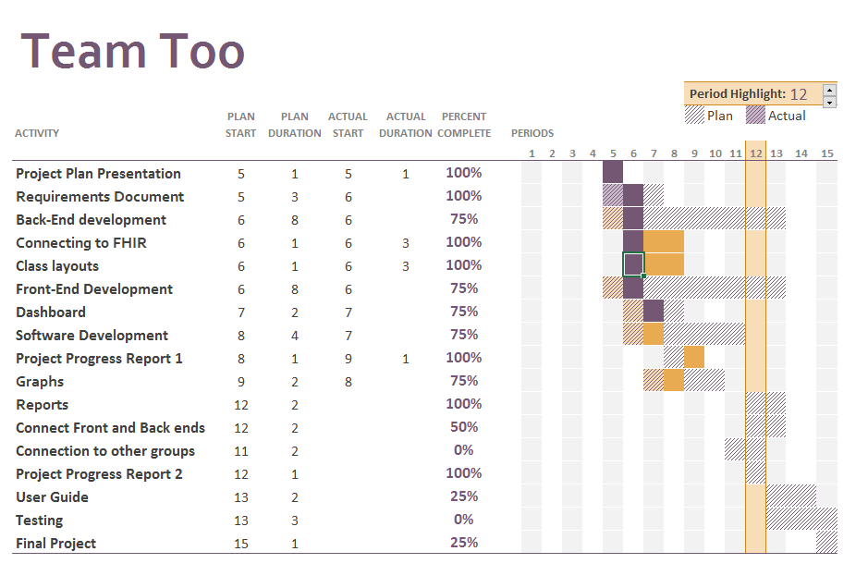
Development -- Gantt Chart
Notes:
Here is a quick update of the Gantt chart. This represents our project plan and our progress so far.
Overall, we’re on pace with the original project plan. In upcoming sections I’ll highlight the details of our progress.

Slide 4
Architectural Design
Highcharts
Javascript charts for GUI
Non-commercial licenses available
AngularJS
Framework for client-side model-view
controller architecture
Frontend
Fast Healthcare Interoperability Resources (FHIR) server
Primary content resource for the application
Backend
HL7.FHIR C# library
Plugin to simply database access
Notes:
The Dashboard is constructed using Highcharts and AngularJS for the front end. This allows for a lightweight, responsive design.
The Backend has been developed in C# and uses .Net HL7.FHIR library to connect with the FHIR server. The Library simplifies working with the server since it conforms to the current FHIR specification.
Ultimately the project will be deployed as a website using Microsoft Azure services

Slide 5


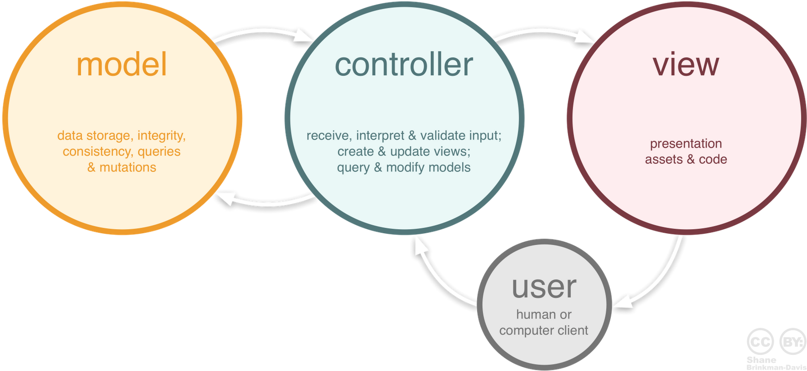
Architectural Design:
Model
Graph data classes
Patient and observation classes
Controller
Sends queries to FHIR server
Agregates and analyzes data
Creates export files
Delivers JSON payload to frontend
View
Generates visual represenation of results
Interface controls
Sends requests to controller
Notes:
The dashboard follows an MVC design template
Models includes a graph data object and patient and observation objects to store the relevant data.
The controller queries the FHIR server, and prepares the data for the frontend or data exports. The controller also delivers the data as a JSON payload to the view.
The view is the visual representation of the results and contains the user interface, triggering requests that will be sent to the controller

Slide 6
Development Update
Previous Milestones
FHIR Server Connection Established
Initial Class Layouts Complete
Analytics for BMI
New Milestones
Data Queries Completed
JSON Payload Finalized
CDC Comparison Data Incorporated
Analytics for BMI, Hemoglobin & Hypertension
Front/Backend Communication Completed
Data Export Completed
Notes:
Our team has made significant progress since the last report
We finalized our quires to the server and the JSON payload that will be used in to communicate between the front & back end
The tool now includes CDC data for results comparison and performs analytics on BMI, Hemoglobin & hypertension
Additionally, the data export tool has been completed and now outputs the results to csv and xml

Slide 7
Development Update
In-Progress Components
Further analytics components
Dashboard controls
Data visualizations and graphics
Important Next Steps
Connection to other applications
Testing
User guide and documentation
Notes:
To finalize this project, we will still need to implement some further analytic components used to aggregate data
Additional dashboard controls and data visualizations are also planned for implementation before the project delivery data
Communication with the other components in the CDC application will need to be implemented
Finally, testing will need to be done and the construction of a user guide and other relevant documentation

Slide 8
Development Challenges
Data Availability
Large data set required
Needed to be generated
Georgia Tech FHIR Server
Bulk requests response capped
Slows load of data
FHIR Query Specifications
Lacks detail for complicated queries
Visualizations and Interfaces
Maintain ease of use
Clean results presentation
Notes:
Since the last report, some of the challenges we’ve faced include the limited data available in the FHIR server. To properly prototype this kind of application we needed to generate a significant amount of data.
The large amount of data needed also causes challenges when communicating with the FHIR server, since responses have a size limit, requiring multiple requests that slow down the application
The FHIR query specifications have caused some challenges, for example creating queries that request subsets of value ranges. This has resulted in the need to query more data than required and then managing the data in the application, again impacting performance.
Finally, Selecting appropriate visualizations and interfaces has presented another challenge. We’ve been striving to provide as much detail and control as posibile to the user while maintaining ease of use and a clean format for the results.

Slide 9
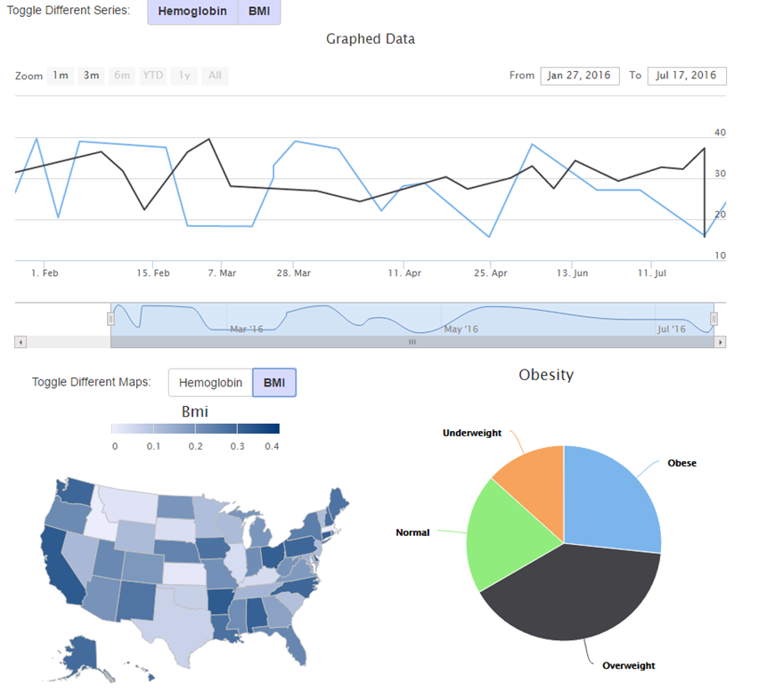
Preliminary Demonstration
Main Results Interface
Historical Results
Current Results
State by State Breakdown
Notes:
We’d like to provide a walkthrough of the current state of the application
Here is the main view of the dashboard, presenting historical BMI and Hemoglobin levels and for a given population in the line charts
A state by state breakdown of the current rates appear in the map on the left, with the % of patients falling in each weight classification shown in the pie chart on the right.

Slide 10
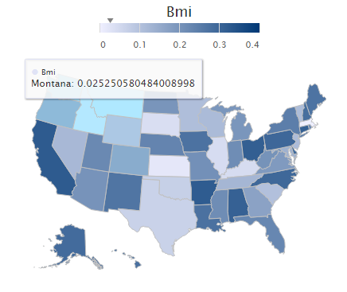
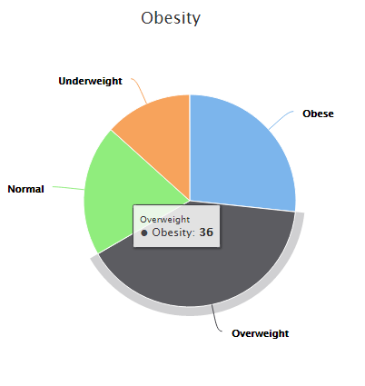
Preliminary Demonstration
Graph Results
Additional Data Shown on Mouseover
CDC Data will be Incorporated for Comparison
Notes:
All of the charts display additional numerical results on mouse over to provide more detail when desired
In future updates, the charts will display national and state level statistics from the CDC to provide context for the results of the selected group.

Slide 11
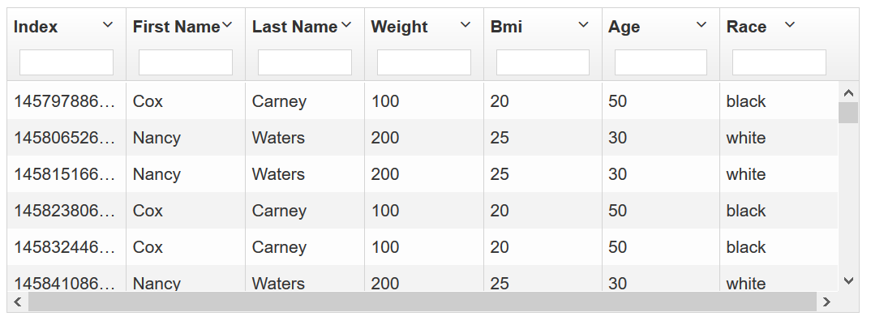
Preliminary Demonstration
Individual Records
Displayed as Grid View
Searchable and Sortable
Sensitive Information Hidden
Notes:
A sortable and searchable grid view is featured underneath the graphical display to provide additional detail.
The tool will modify displayed information based on the login.
Patient identifiable information will be hidden if the logged in party is not privy to said information.

Slide 12
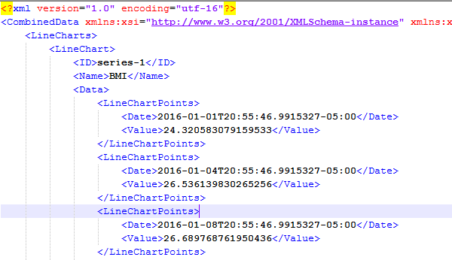
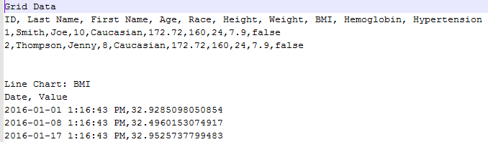
Preliminary Demonstration
Data Export
All Results Exportable
CSV or XML Format
XML Output
CSV Output
Notes:
Easy export of the results to the common CSV and XML formats has been implemented
After selecting the desired population, a single click will generate an export including all the chart data and the individual grid data.
Similar to the grid view, sensitive data will be hidden if appropriate.

Slide 13
Upcoming Features:
Interface controls for subgroup selection
Filter on Age, Gender, Race
Finalized presentation
Integration with CDC Data
Additional analytics
Communication with other components
Deployed on Microsoft Azure
Notes:
As you can see, we’ve made significant progress since the last report, but a few items remain to be implemented
Interface controls are currently limited and need to be expanded.
The presentation of the results will finalized and some additional analytics will be added
Finally, the dashboard will be incorporated into the larger CDC application.
The application has been tested on Azure is ready to deploy

Slide 14
Thank You!
Project Manager
Developer
Daniel Hegberg
Data analysis & reporting
Frontend Developer
Backend Developer
David Bailey
Team-Too
David Stevens
User Interface Design
Report generation
Quality Assurance
Team Liaison
Kirk Pastorian
Research & Testing

